Slide 1
Irony Detection in English Tweets
Group 15:
M S Nishanth CS18MTECH11005
Nikhil P Kumar CS18MTECH11017
Sharath R CS18MTECH11026

Slide 2
“I just love when you test my patience!”
What sort of emotion does it convey?

Slide 3
Introduction
The expression of one's meaning by using language that normally signifies the opposite, typically for humorous or emphatic effect.
Types:
Situational irony
Dramatic irony
Socratic irony
Verbal irony

Slide 4
Irony Detection has become crucial for the improvement of natural language processing tasks like sentiment analysis. Its importance can be understood from the fact that its presence can significantly undermine accurate analysis of opinions and sentiment in such texts.
In this project, we are mainly focusing on verbal irony.

Slide 5
Motivation
>> To build a stronger partnership between humans and machines, it is vital to move away from a world where humans have to understand machines to a world where the machines understand us, answering (and behaving) in the way a human would do. ​

Slide 6
Irony Detection in English Tweets
The emergence of social web has moved a large part of our daily communications online. Recently there has been an increased research interest in text mining on social media data. The popularity of Twitter and the availability of the Twitter API have made datasets of tweets popular for irony detection. Twitter can also provide access to additional context by using supplementary datasets like the set of complete twitter timeline. The usage of categorical labels by the authors of the tweet in the form of irony hashtags (eg: #irony, #not, #sarcasm) is helpful in detecting irony in tweets and minimises the annotation effort.

Slide 7
Motivation
>> Understanding Emotions in Textual Conversations is a hard problem in absence of voice modulations and facial expressions.
Humanizing AI means integrating emotions into the ecosystem, aligning emotional intelligence, i.e. the Emotional Quotient (EQ) with normal intelligence (problem solving), i.e. Intelligent Quotient (IQ).

Slide 8
Challenges
Irony introduce new challenges to many text-related tasks including information retrieval (IR), classiﬁcation, and clustering.
Mere identification of a word as polar (positive or negative) word is inadequate for fine-grained sentiment analysis which results beyond positive or negative.
There are many hidden properties of words other than being positive or negative which can lead to enrichment of existing sentiment analysis.
This work focuses on finding these properties in polar words in light of different applications of sentiment analysis.

Slide 9
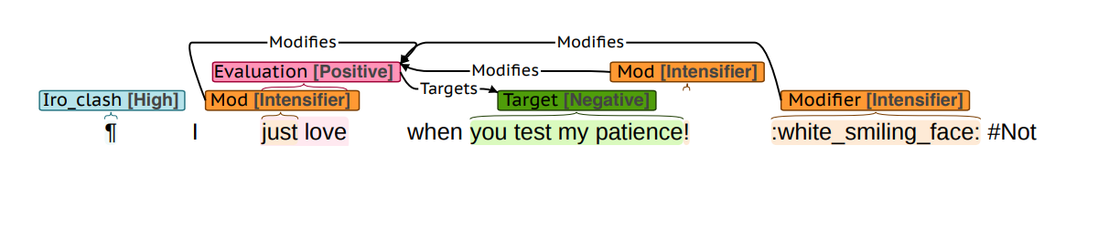
Brat annotation

Slide 10
Problem Definition
P1:We try to solve a two-class (or binary) classification where the system has to predict whether a tweet is ironic or not. The following sentences present examples of an ironic and non-ironic tweet, respectively.
P2: The second problem is a multiclass classification where the system has to predict one out of four labels describing
verbal irony realized through a polarity contrast,
verbal irony without such a polarity contrast
descriptions of situational irony
iv) non-irony

Slide 11
Approaches
Rule Based Approach : It attempts to identify sarcasm through specific evidences captured in terms of rules that rely on indicators of sarcasm.
Statistical Approach : Statistical approaches to irony detection vary in terms of features and learning algorithms. Most of the approaches use bag-of-words as features.
Deep Learning based Approach : The use of architectures based on deep learning can be used to get an improvement in performance.

Slide 12
Paper 1: Exploring the Automatic Recognition of Irony in English Tweets
The main goal of the annotation guidelines is to develop a set of reproducing coding principles to detect irony in social media text. We define irony as an evaluative expression whose polarity is inverted between the literal and the intended evaluation, resulting in an incongruence between the literal evaluation and its context. At the tweet level, annotators indicated whether the tweet is (i) Ironic by means of a clash, (ii) Another type of irony (Eg: Situational), or was (iii) Not ironic. Since we are interested in a binary classification, we are merging the first and second categories into one.

Slide 13
Paper 2: Exploring the Realization of Irony in Twitter Data
As the first step, the annotators annotate each tweet as ironic, possibly ironic or non ironic. According to this annotation scheme, a tweet is considered ironic if it presents a polarity change between the literal and the intended evaluation. There are three ways in which evaluation polarity can be changed: by using
(i)Opposition: The literal evaluation is opposite to the intended evaluation
(ii)Hyperbole: The literal evaluation is stronger than the intended evaluation
(iii)Understatement: The literal evaluation is stronger than the intended evaluation

Slide 14
Feature Engineering
We extracted the a number of features from the dataset. These features would help us explain the tweets to machine in a better way.
Lexical features
Syntatic features
Sentiment features
Semantic features

Slide 15
As lexical features
Bags-of-words (BoW) features.
We incorporated token unigrams and bigrams and character trigrams and fourgrams.
Character
Punctuation flooding
Capitalisation
Hashtag frequency
Hashtag-to-word ratio
Emoticon frequency
Tweet length.

Slide 16
Syntactic features--->
For each PoS-tag
whether it occurs in the tweet or not (binary)
whether the tag occurs 0, 1, or > 2 times
the frequency of the tag (absolute numbers)
the number of interjections (exclaimations count)
named entities
named entity present or not (binary).
the number of named entities in the text
the number of tokens part of named entity.
frequency of tokens that are part of a named entity.

Slide 17
Sentiment lexicon features (6), implemented based on existing sentiment lexicons:
AFINN (Nielsen, 2011)
MPQA (Wilson et al., 2005)
NRC Emotion Lexicon (Mohammad and Turney, 2013)
For each lexicon
number of positive, negative and neutral lexicon words averaged over text length;
the overall tweet polarity (i.e., the sum of the values of the identified sentiment words);
the difference between the highest positive and lowest negative sentiment values;
a binary feature indicating whether there is a polarity .
The sentiment lexicon features were extracted in two ways:
by considering all tokens in the

Slide 18
Semantic information --->
used word embedding cluster features generated with Word2Vec (Mikolov et al., 2013).
In this word embeddings, are the distributed vector representation of words that capture the syntactic and semantic relationships among words.
Maps Love and Hate together.

Slide 19
vector('Paris') - vector('France') + vector('Italy') results in a vector that is very close to vector('Rome'), and vector('king') - vector('man') + vector('woman') is close to vector('queen')
word2vec : continuous bag-of-words and continuous skip-gram -cbow

Slide 20
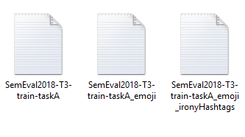
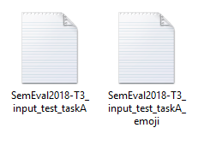
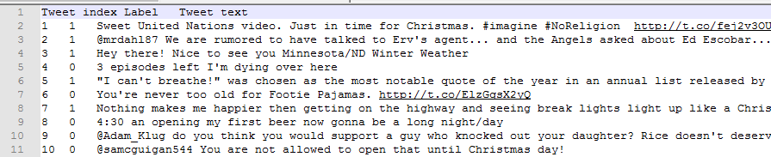
DataSet

Slide 21
Experiment
Preprocessing
We normalised hyperlinks and @-replies or mentions to http://someurl and @someuser, respectively.
Other preprocessing steps involve tokenisation ,PoS-tagging, lemmatisation and [named entity recognition].
Extracted Features
Lexical features -10
Syntatic features -104
Sentiment features -16
Semantic features -*

Slide 22
Model Training
We used SVM to train on the DataSet.

Slide 23
Model Training- proposed
Model Training- proposed new feature
Sentiment-Specific Word Embedding.
Bag of Words
GloVe
KNN

Slide 24
References
Van Hee,C., Lefever, E., and Hoste, V. (2016). Exploring the Automatic Recognition of Irony in English tweets
Van Hee,C., Lefever, E., and Hoste, V. (2016). Exploring the Realization of Irony in Twitter Data
Joshi, A., Bhattacharyya, P., Carman, M. (2016). Automatic Sarcasm Detection: A Survey

